Slide 1
Project 2
James Bilbrey, Luke Carrico, Benjamin Nace

Slide 2
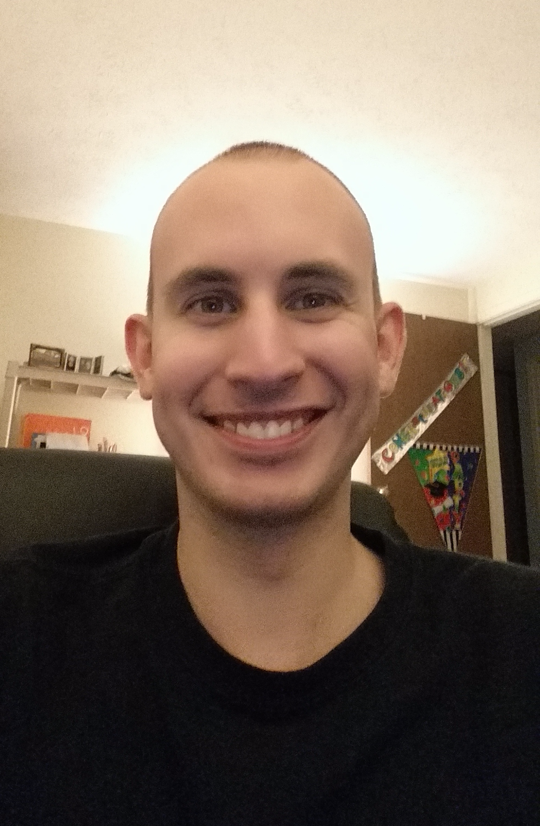
James Bilbrey
Rank: Junior
Relevant Experience:
~3.5 years volunteer work programming content for an online gaming community
Fortes:
Java | C++
git | ssh
scripting languages

Slide 3
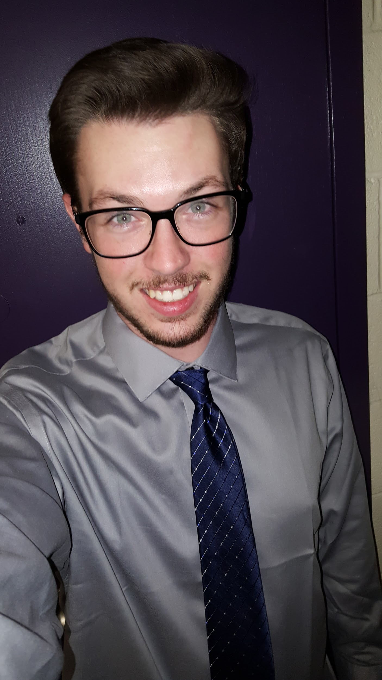
Luke Carrico
Rank: Sophomore
Relevant Experience:
Tech Consultant for Castle Master/C & H Homes
Website manager/ Tech Consultant/ Intern for the Campaign to Elect Chris Chaffee (2014)

Slide 4

Benjamin Nace
Rank: Sophomore
Relevant Experience:
Internship at Imaging Research Center on UMBC’s Campus
Working on team of 4
Building website in PHP with a MySQL database
Using git for source control

Slide 5
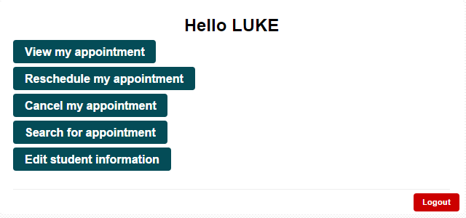
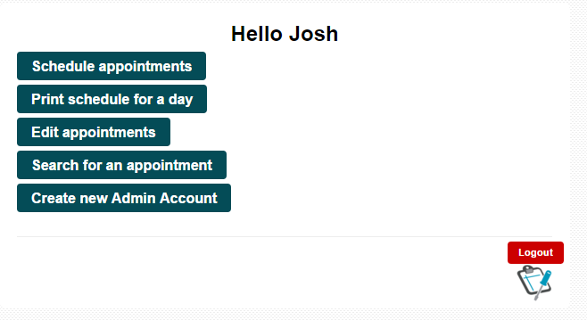
Website Features
Student Side:
Sign up for a specific appointment
Sign up for the next available appointment
View appointment
Reschedule appointment
Cancel appointment
Search for appointments
Advisor Side:
Schedule appointments
Print the schedule for today, or any given day
Edit and cancel appointments
Search for appointments by day, time, type, advisor, and/or student information.
Create new advisor accounts

Slide 6
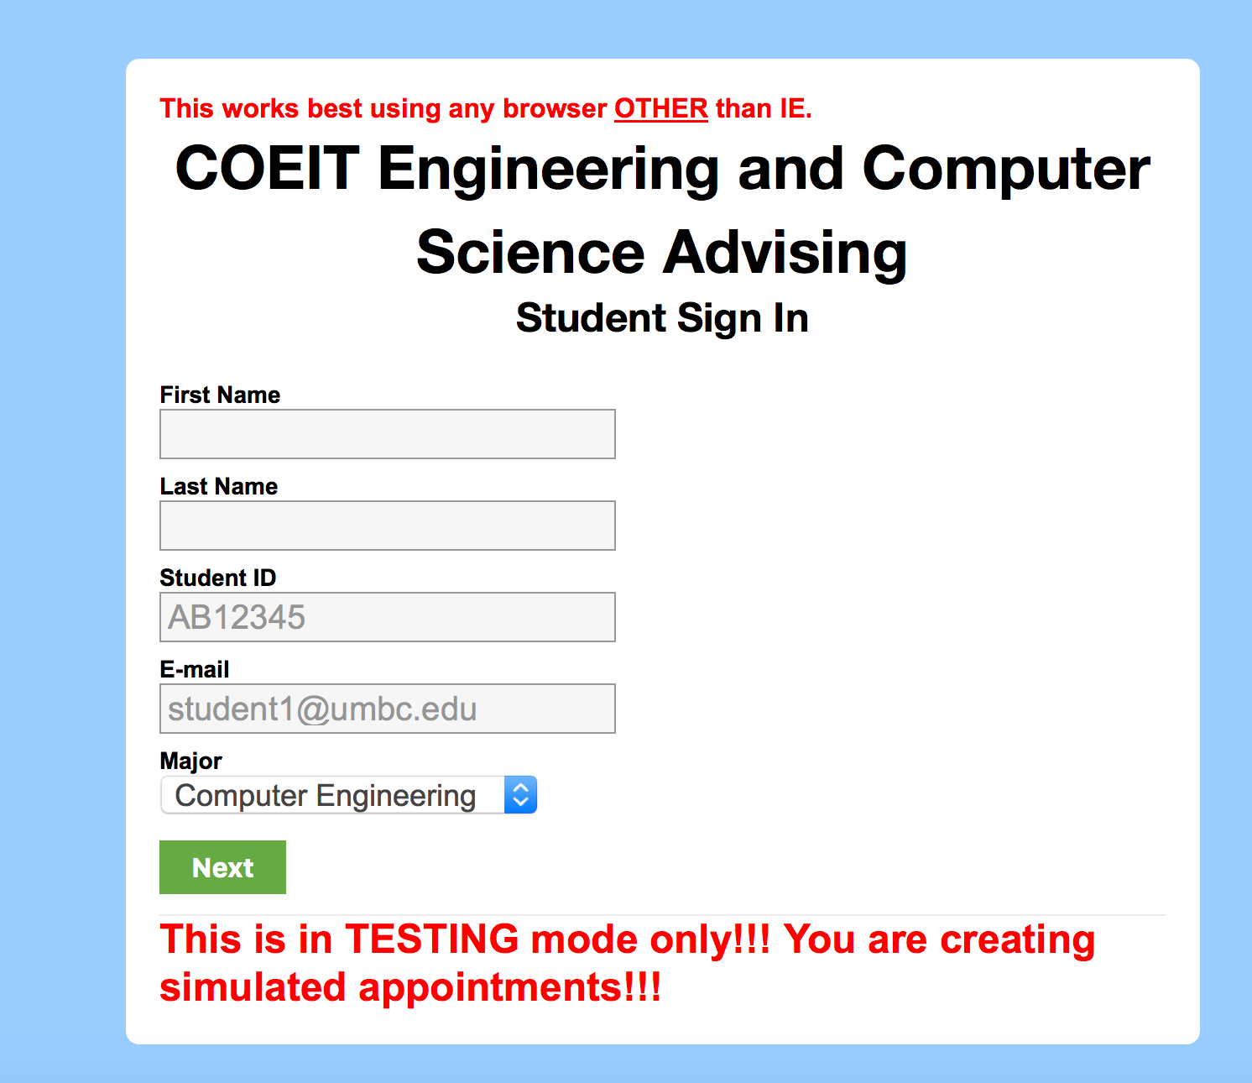
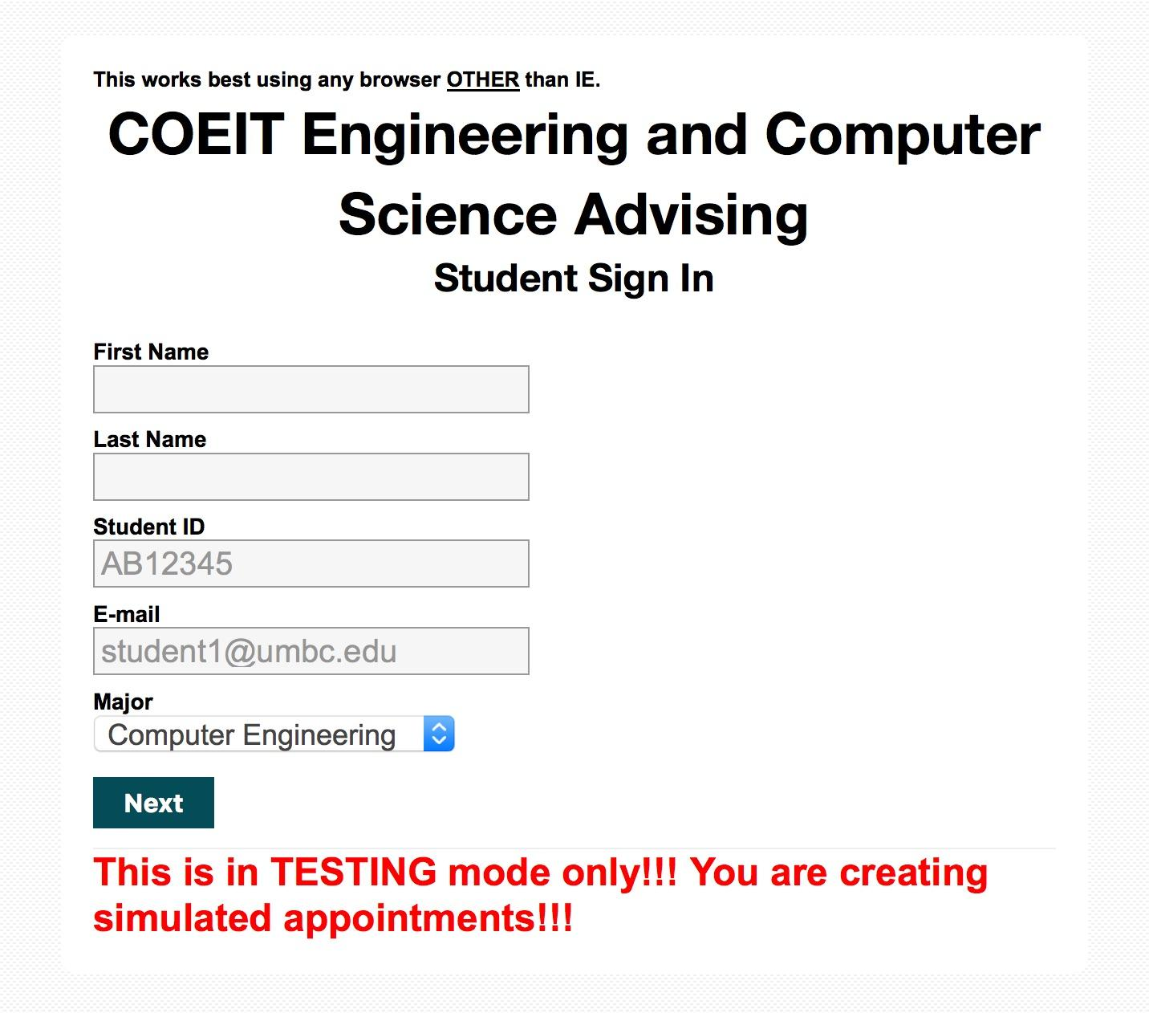
CSS Styling Changes
Part of this project was to change the overall look of this project. What we did was we tried to match the color scheme of the UMBC COEIT page, so we matched the background image, and we used the navigation stripe color as our button color with the button hover color matching the menu bar.

Slide 7
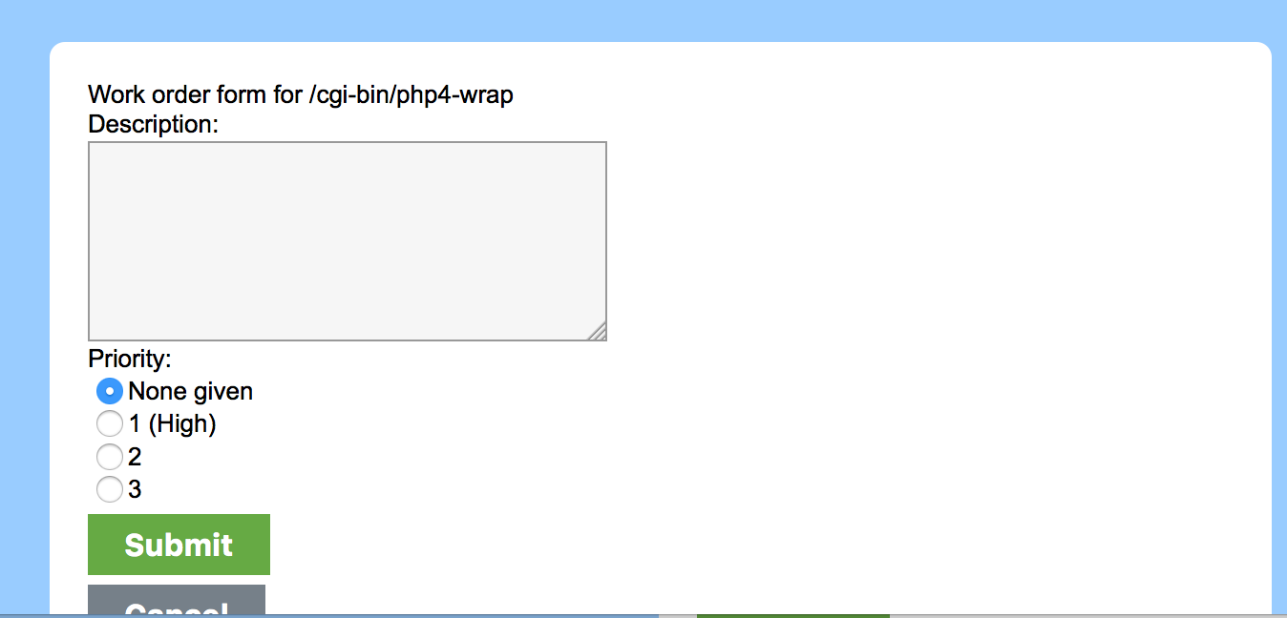
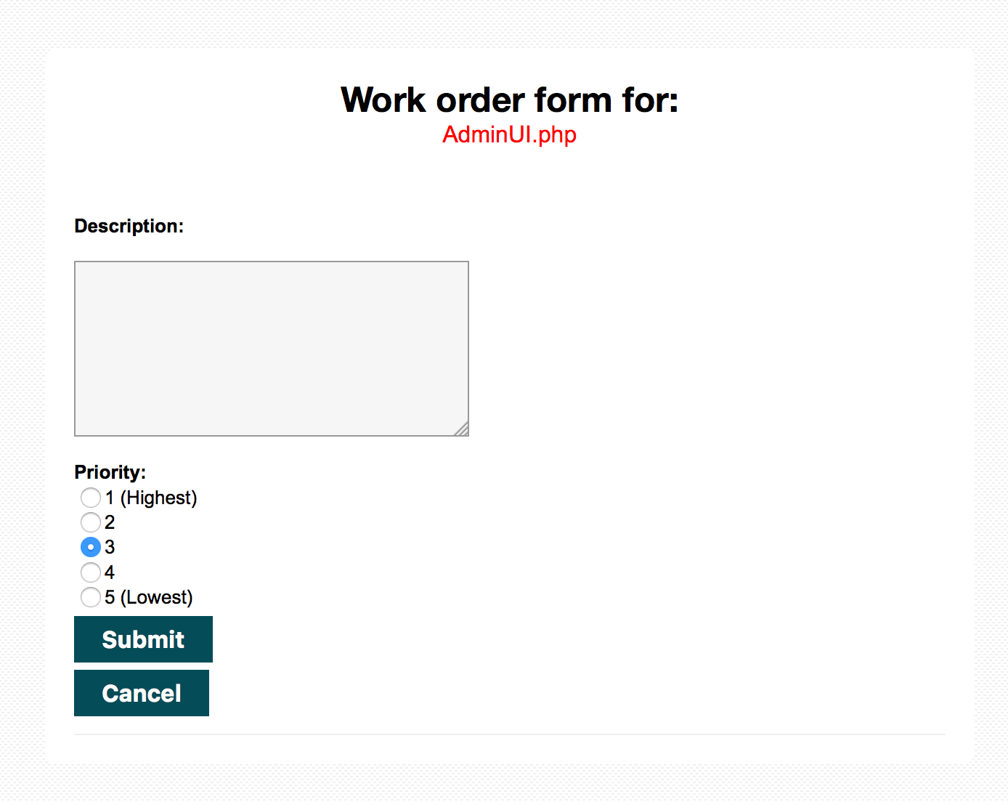
Work Order
Another one of the changes we were supposed to make was to make the work order form screen look better. Before, the page name didn’t work, and the screen that opened didn’t fully show the entire work order screen. We made the new work order page match the layout of the other pages and made the Page Name information work. We changed the priority choices, and stretched out the window so that everything shows when opened.

Slide 8
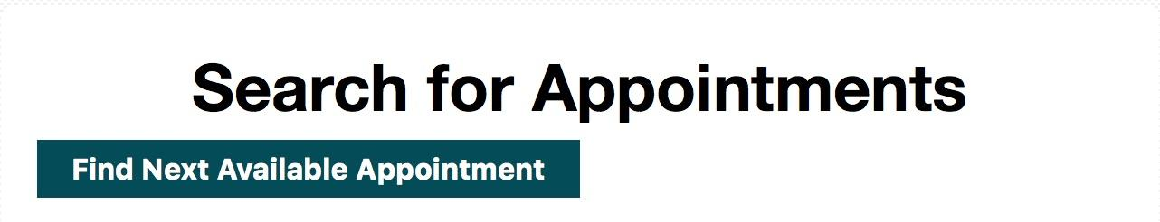
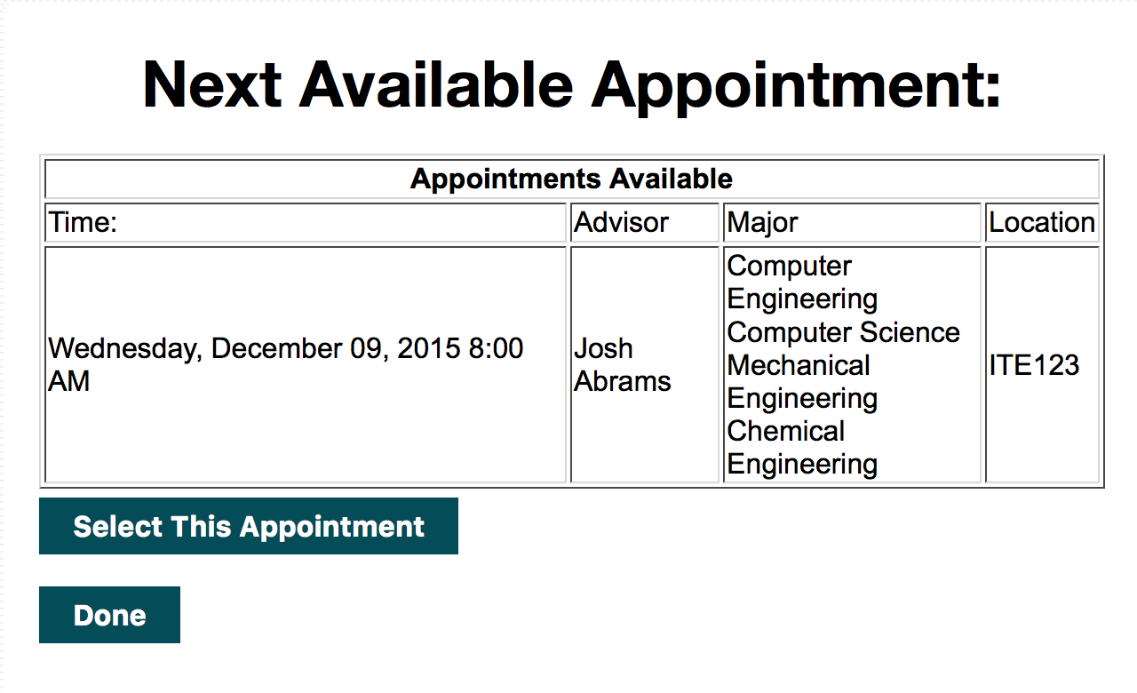
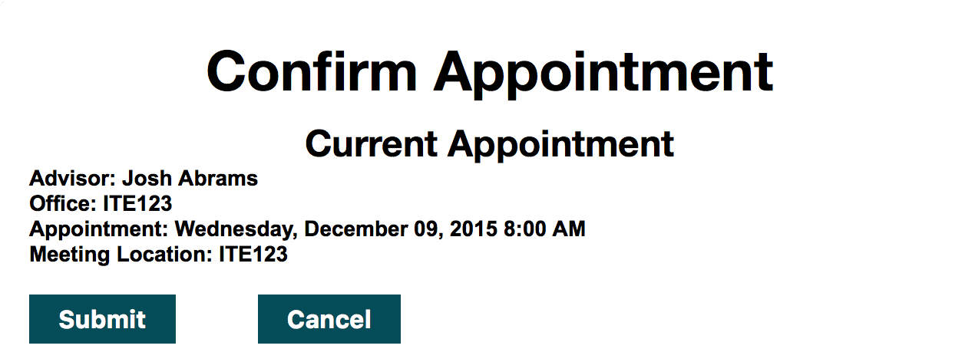
Find Next Appointment
Another addition was the Find Next Available Appointment button. Found in the Search for Appointments page on the student side, this button allows the student to see the next available appointment, then it gives the option to go back or sign up for the appointment

Slide 9
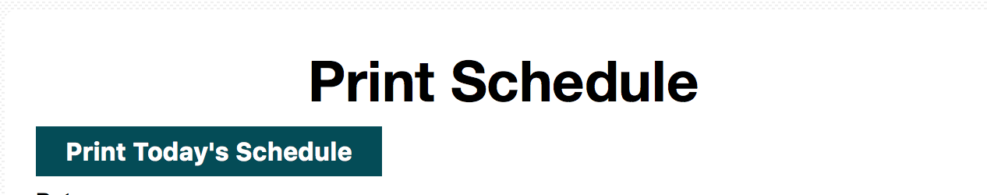
Print Today’s Schedule
This button, located on the Print Schedule page of the admin side, gives the admin the ability to easily print out the group schedule and his/her individual schedule for that day. When clicked, the web page gets the current date from the computer, and it uses that day over an inputted date to print the schedule

Slide 10
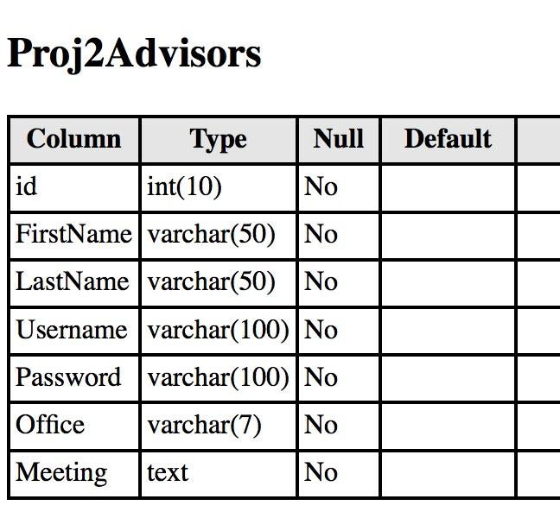
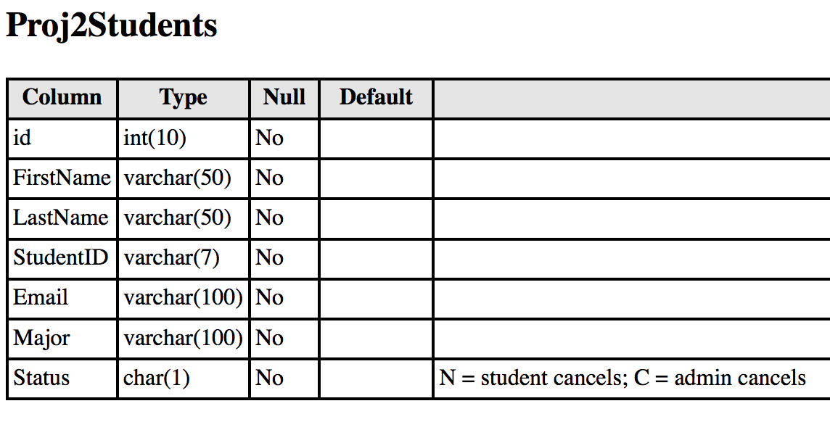
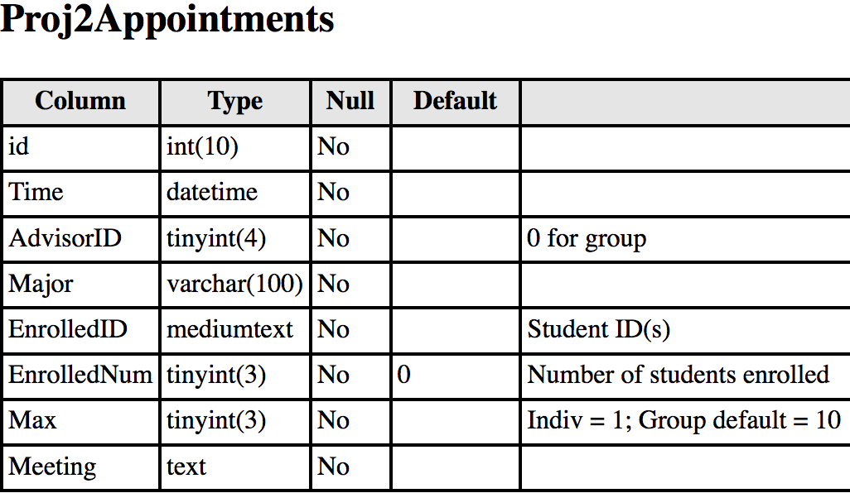
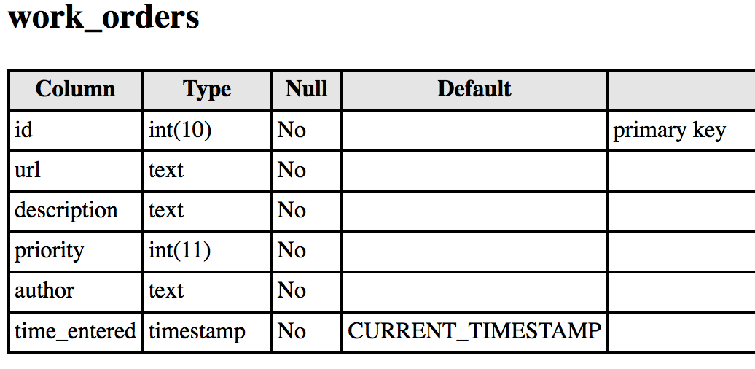
Database Setup

Slide 11
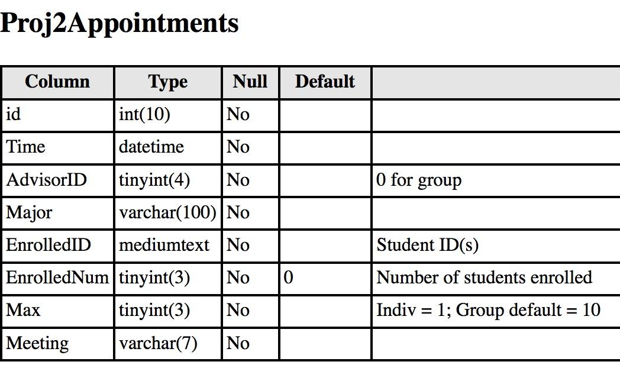
Office and Meeting Locations
Another part of this project was to add fields in the database for the advisors’ offices and where they would be meeting students. The advisor’s office was added to the Proj2Advisors database, and the meeting location was added to both the Proj2Appointments and Proj2Advisors database for easier access.

Slide 12
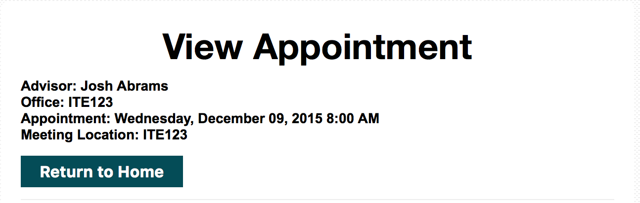
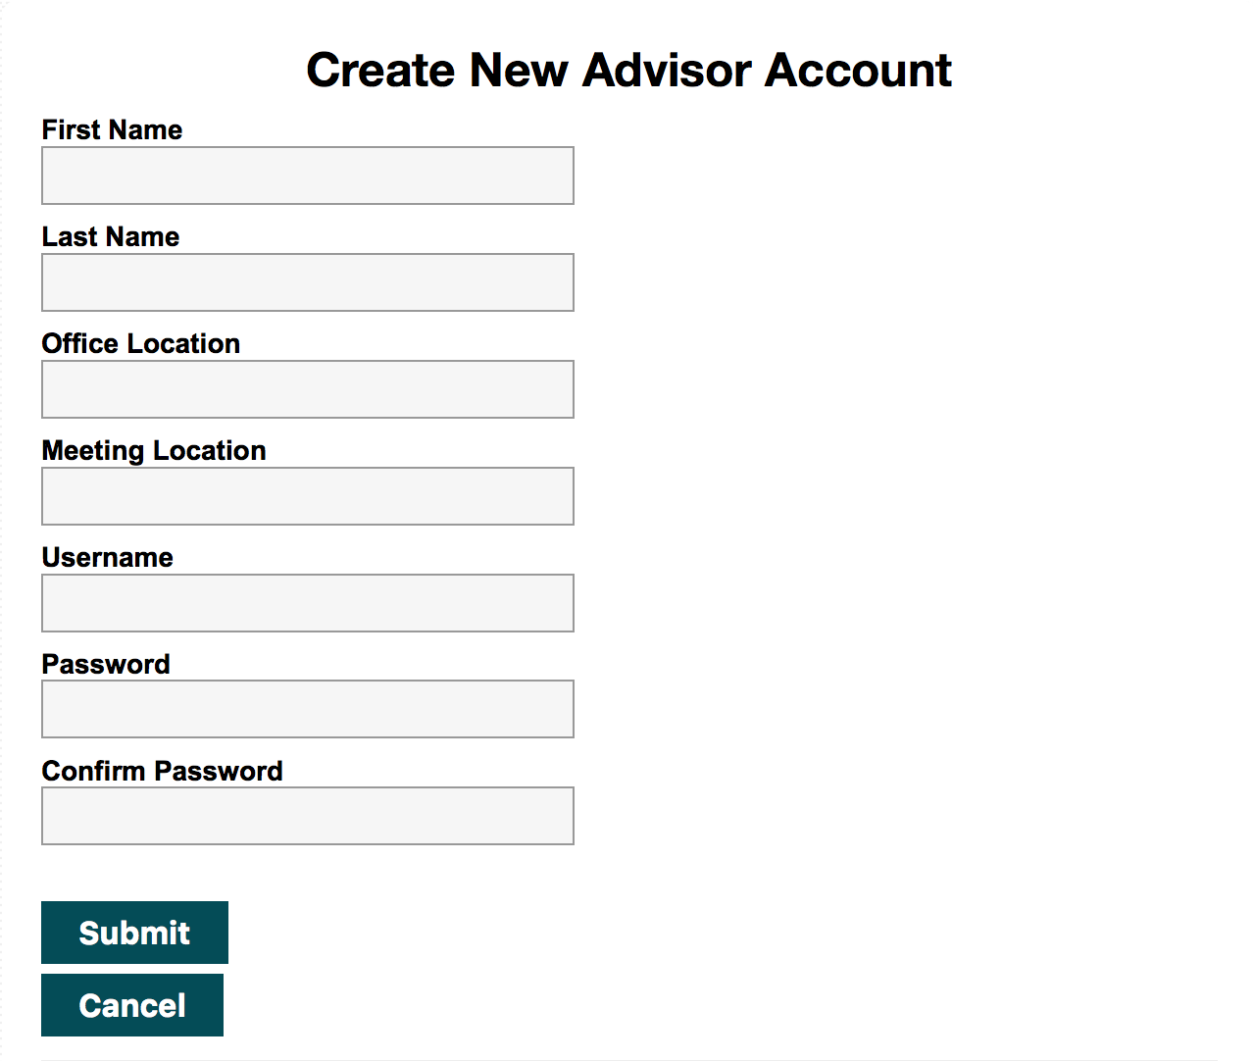
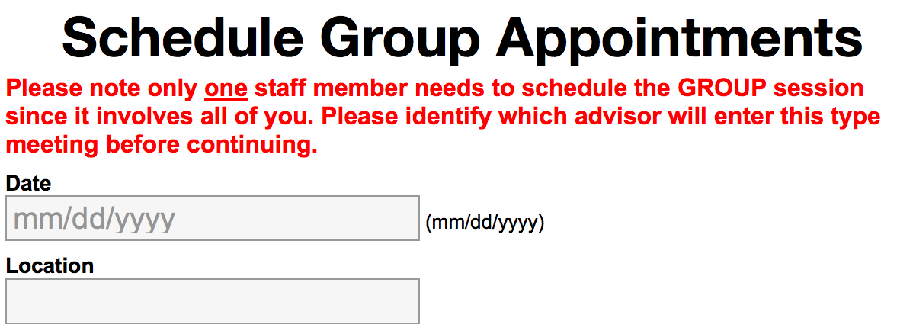
Office and Meeting Locations (Contd.)
The advisor’s office location and the advising meeting place have been added to the view appointment page. In Schedule Group Appointments, the advisor has the option to set the location of the group appointment(s). The meeting location is done automatically for new individual appointments because in the Create New Advisor Account page, in order to create a new advisor, one must input the advisor’s office and where they will be holding appointments.

Slide 13
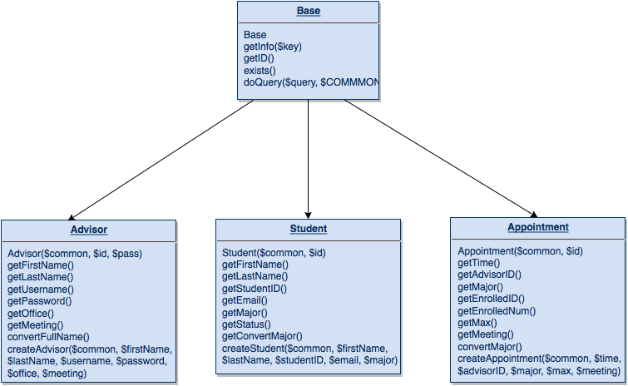
Session Variable Reduction
A major portion of this project involved removing session variables from this website. Session variables are variables that carry information between pages. We eliminated every variable except for $userID by creating classes to get the information that would have been stored by creating different methods. These classes have functions that use the base class to interact with the databases. This also reduces SQL Queries throughout the project.

Slide 14
How We Shared the Work
Ben: Created classes used to reduce $_SESSION variables on student and admin side, Debugging, Database Setup, and removed the session variables from the files
Luke: CSS, Debugging, Work Order, Find Next Appointment, Print Today’s Schedule, File Setup, Presentation, and Binder
Jim: Footer Replacement, Advisor Password Encryption using the MD5 Hashing Algorithm, Create New Advisor page, Slick Sheet

Slide 15
Challenges
Issues at first when removing the $_SESSION variables because of how integrated they were in the website.
Issues where the different classes wouldn’t have the proper function setup to perform an operation, so they had to be modified as we went.
Classes were originally designed for PHP 5, which has full OOP features, such as protection levels, static functions, and static member variables
School server runs PHP 4, which does not have these, so classes had to be rewritten
In Work Order, trying to get the page name to show up properly took some work.

Slide 16
In our next release
In our next release, we would like to:
Include a sign in page for the students
Make the overall website more aesthetically pleasing by adding more design to the pages
Include a status bar that would show appointment information when a student signs up for an appointment
Include an e-mail advisor button for the students
Properly add the ability to change the meeting location. This sounds like it would just be a simple change of location, but it would also require some kind of notification system for the students enrolled, so they would know that the location changed
Include support for more majors.
Add support for a date selection calendar that would show when appointments are available
Add ability to export appointment information to an advisor’s calendar.

